Slide 1


Slide 2
NURSING LEADERSHIP IN EUROPE
Alessandro Stievano
PhD, MNursSci, MSoc, MEd, FAAN, FEANS, FESNO, FFNMRCSI, FTNSS
Chief Nursing Officer (CNO) FNOPI for Italy
Associate Editor "Journal of Nursing Scholarship"
Vice-President European Nurse Director Association (ENDA)

Slide 3
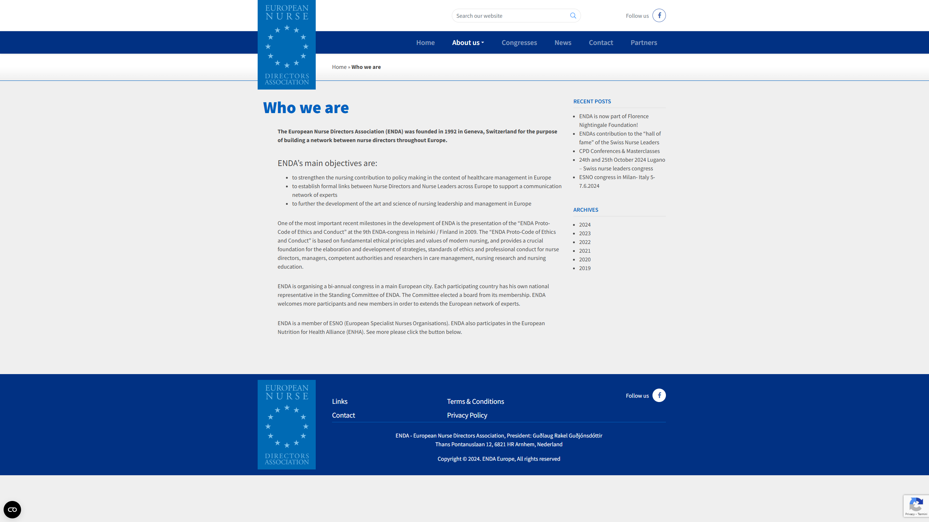

Slide 4
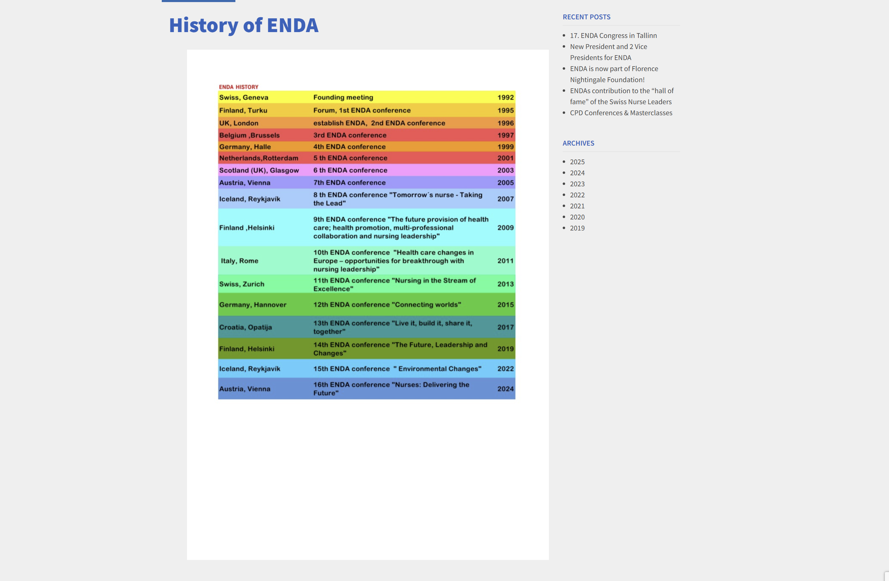

Slide 5
ENDA vision
Strengthening of the nursing profession
and influence in Europe
Aim
ENDA
Aim
ENDA
Aim
ENDA
Aim
Promotes nursing leadership and innovation
Strengthens nursing contribution to policy making
Influences nursing education and practice
ENDA
Promotes nursing research

Slide 6
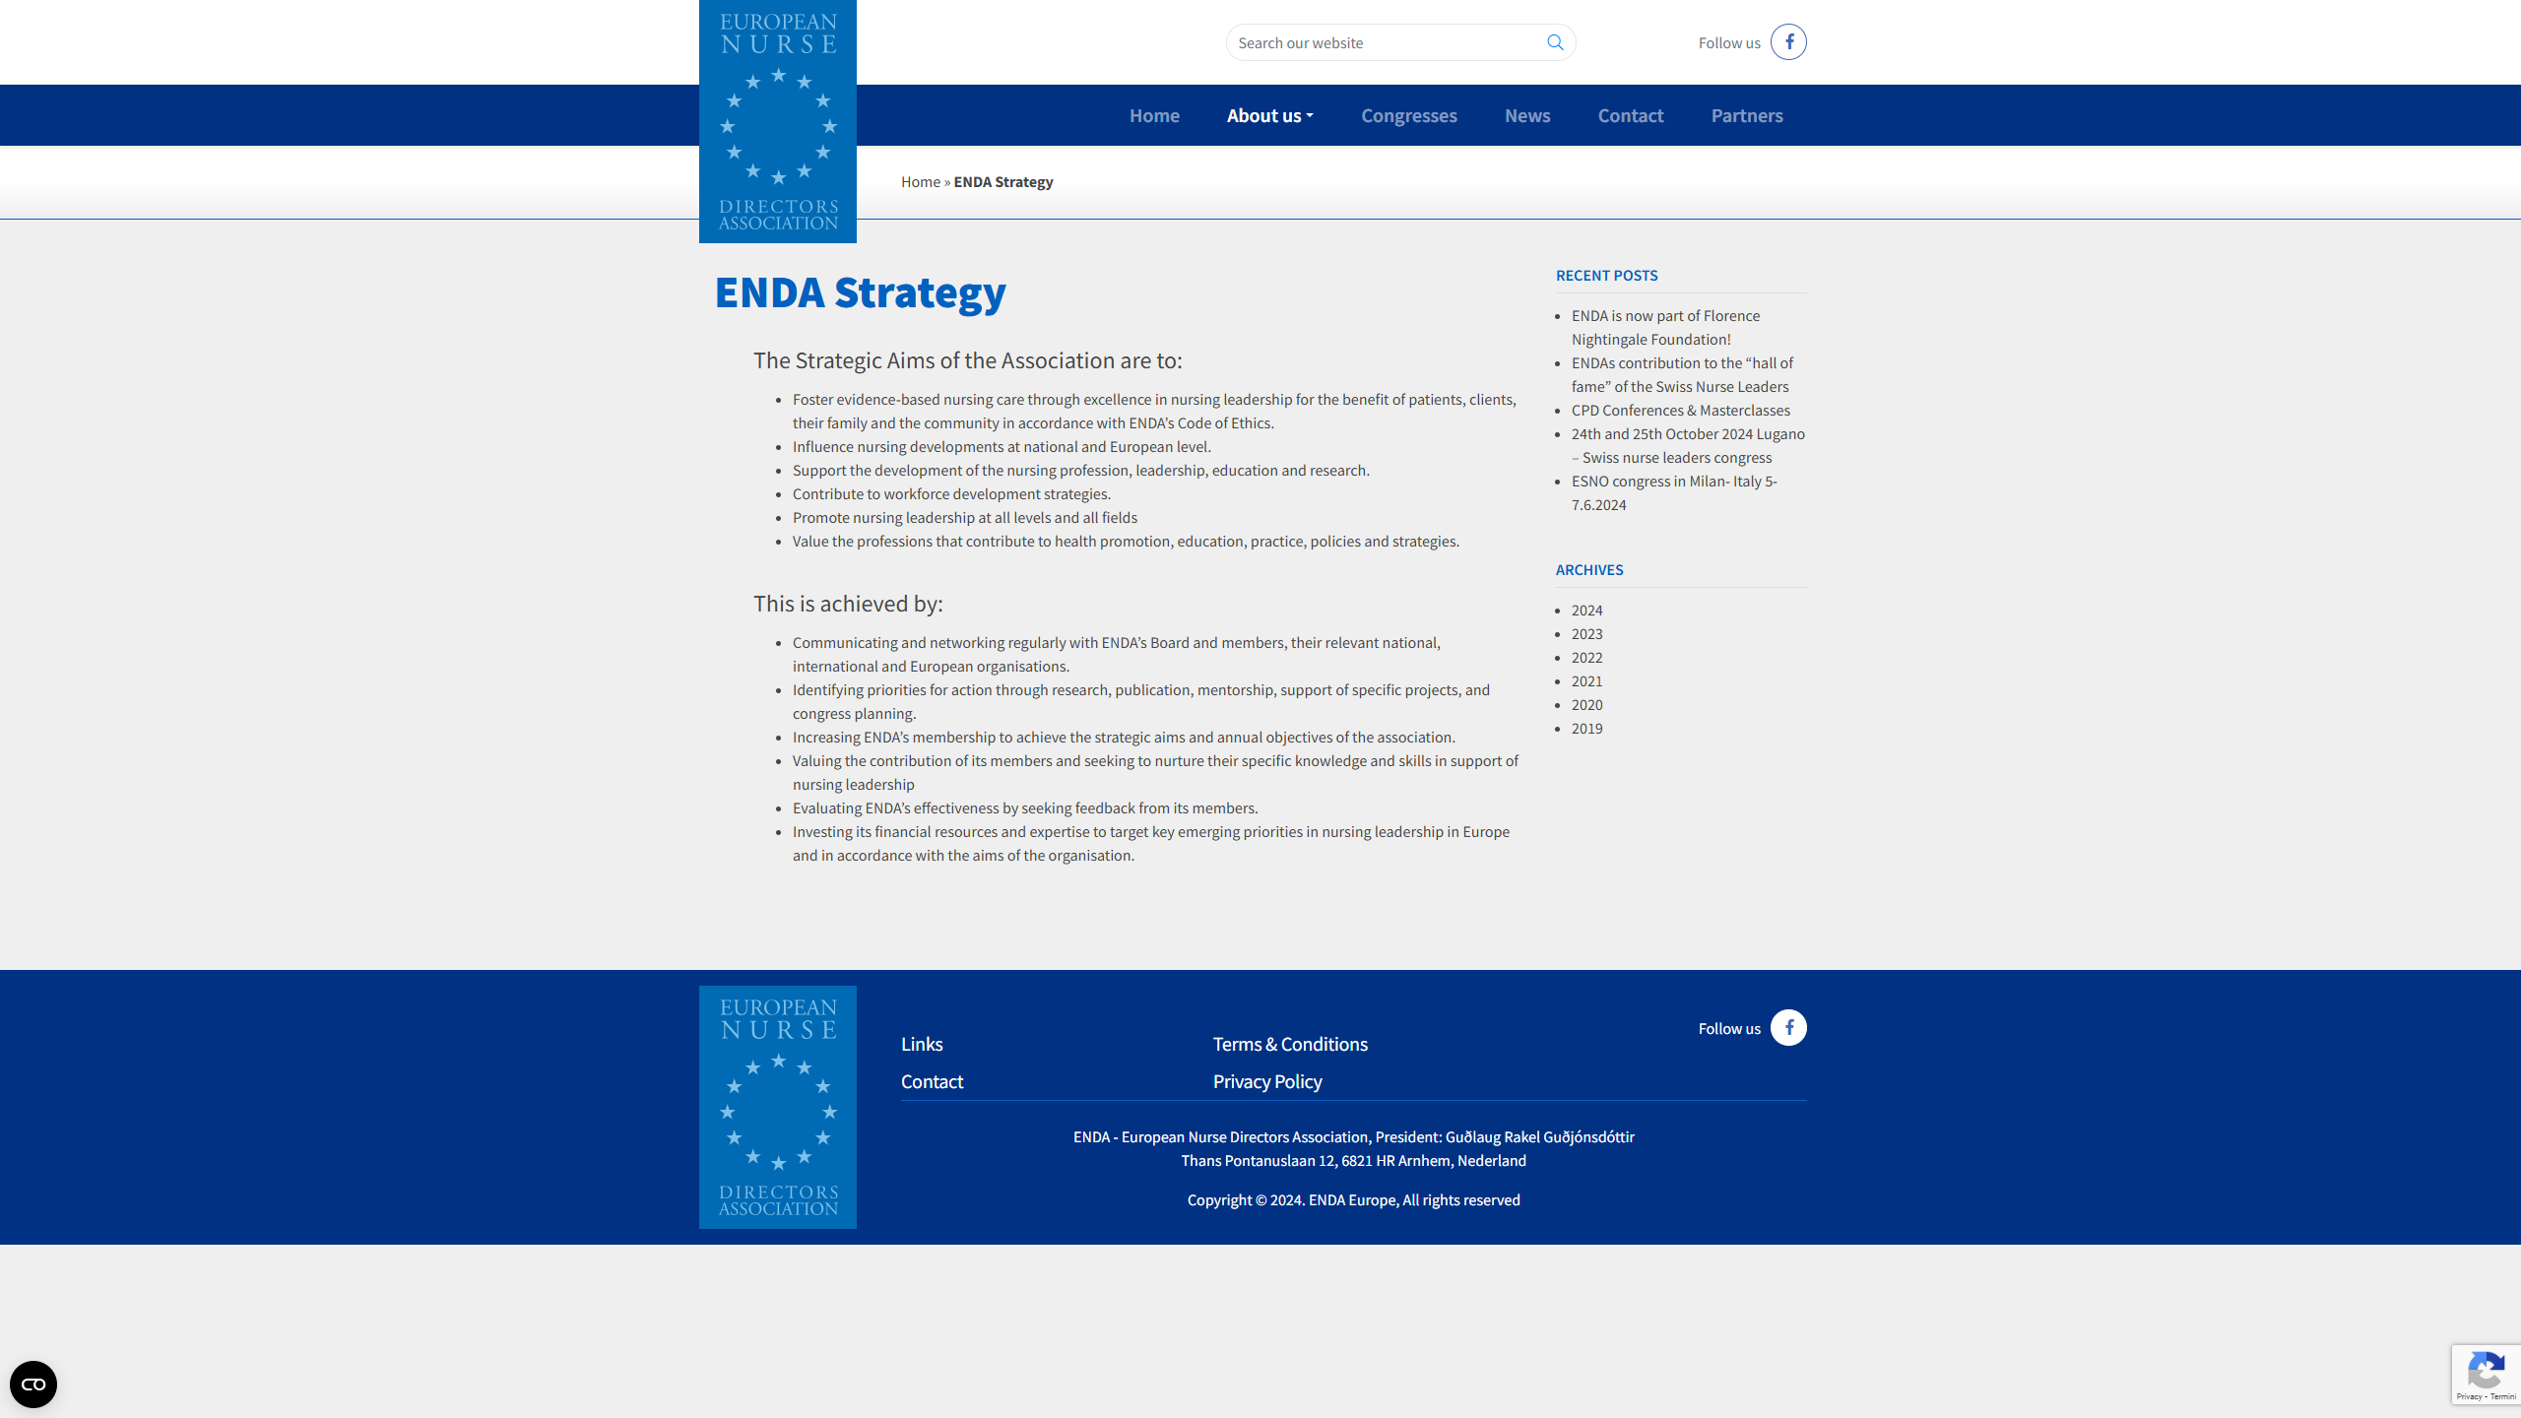

Slide 7
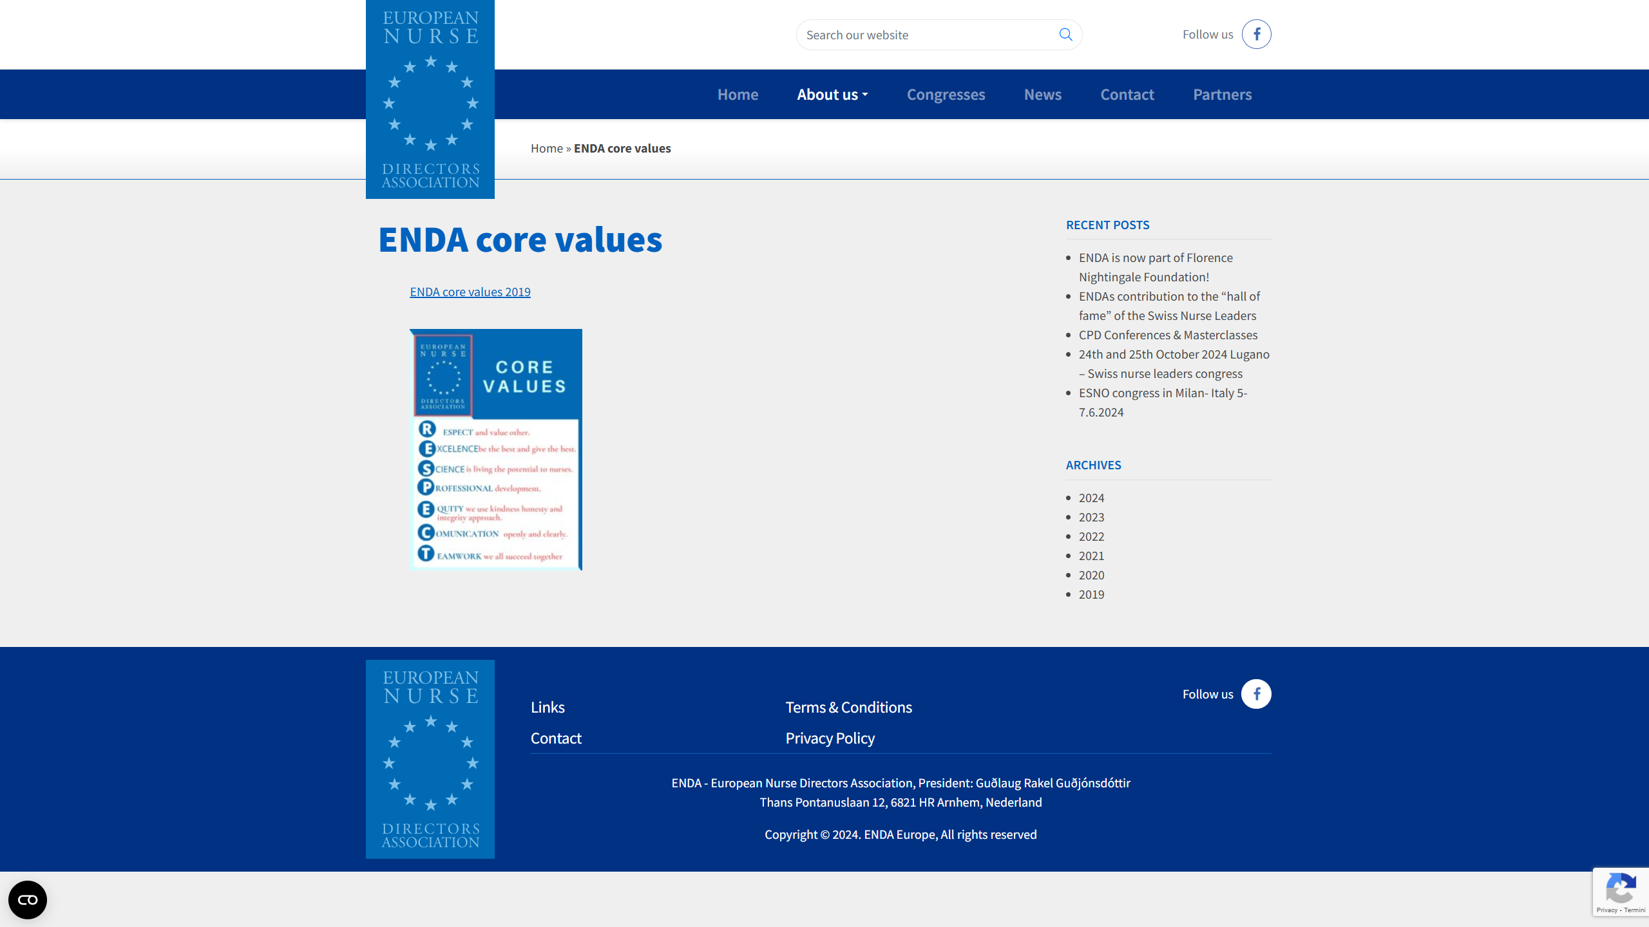

Slide 8

Implementation and
Monitoring
The board will involve and activate members to take the strategy implementation forward with the Nursing Association in their own country
According to the vision – the board will collectively decide on a plan of action for the following years. At this point the board will make a review and assess the progress made over last years.
The board will collectively decide annually on a forward plan of action for the following year
The annual report will list significant outcomes identified. Focal points will be shared with ENDA members.

Slide 9

Changing Healthcare Delivery Landscape
Inpatient-centric care replaced with the center of care in the community settings due to the increasing ageing of all populations in the world
Traditional organizational boundaries dissolving
New technologies disrupting the rituals of practice
Leaders communicating across many applications and social mediums
Notes:
Nurse executives will lead across cultures and generations with different values and expectations
Leaders will lead through influence with a social process guiding alignment and commitment – thinking of possibilities instead of constraints, comfortable with big data to make informed decisions constantly testing new ideas
Nurse executives will be evaluated on their agility, creativity and ability to connect teams

Slide 10
Skill Requirements for Next Generation Healthcare
Healthcare systems will employ staff with different skills, including:
  Digital know-how
  Leading in complex organizations
  Creativity
  Entrepreneurship, adaptability, critical thinking and problem solving

Slide 11
Nurse Leader Skill Requirements
Strategic thinking and decision making
Creative thinking and entrepreneurship Executive presence and communication skills
Innovation and change leadership
Executive business skills and big data
Artificial intelligence as a useful instrument for leadership

Slide 12
Organizational Challenges at global level
Shortage of nursing staff and personnel
Overall staff physical and emotional burnout
Abandonment of the job
Retention of the personnel
Poor working conditions, low pay, high workloads and lack of career opportunities
Inadequate personal safety kits and supplies
Deficiency of medical devices and equipment

Slide 13
Role of Nurse Leaders and Managers
Support individual staff and team resilience
Mitigate staffing shortages through innovative planning
Empowerment through training and education
Timely and appropriate interventions and decisions
Encourage teamwork and spirit of solidarity
Providing adequate supplies and equipment
Having sympathy and emotional support to staff
Knowledge of evidence-based practice in management decisions

Slide 14


Slide 15
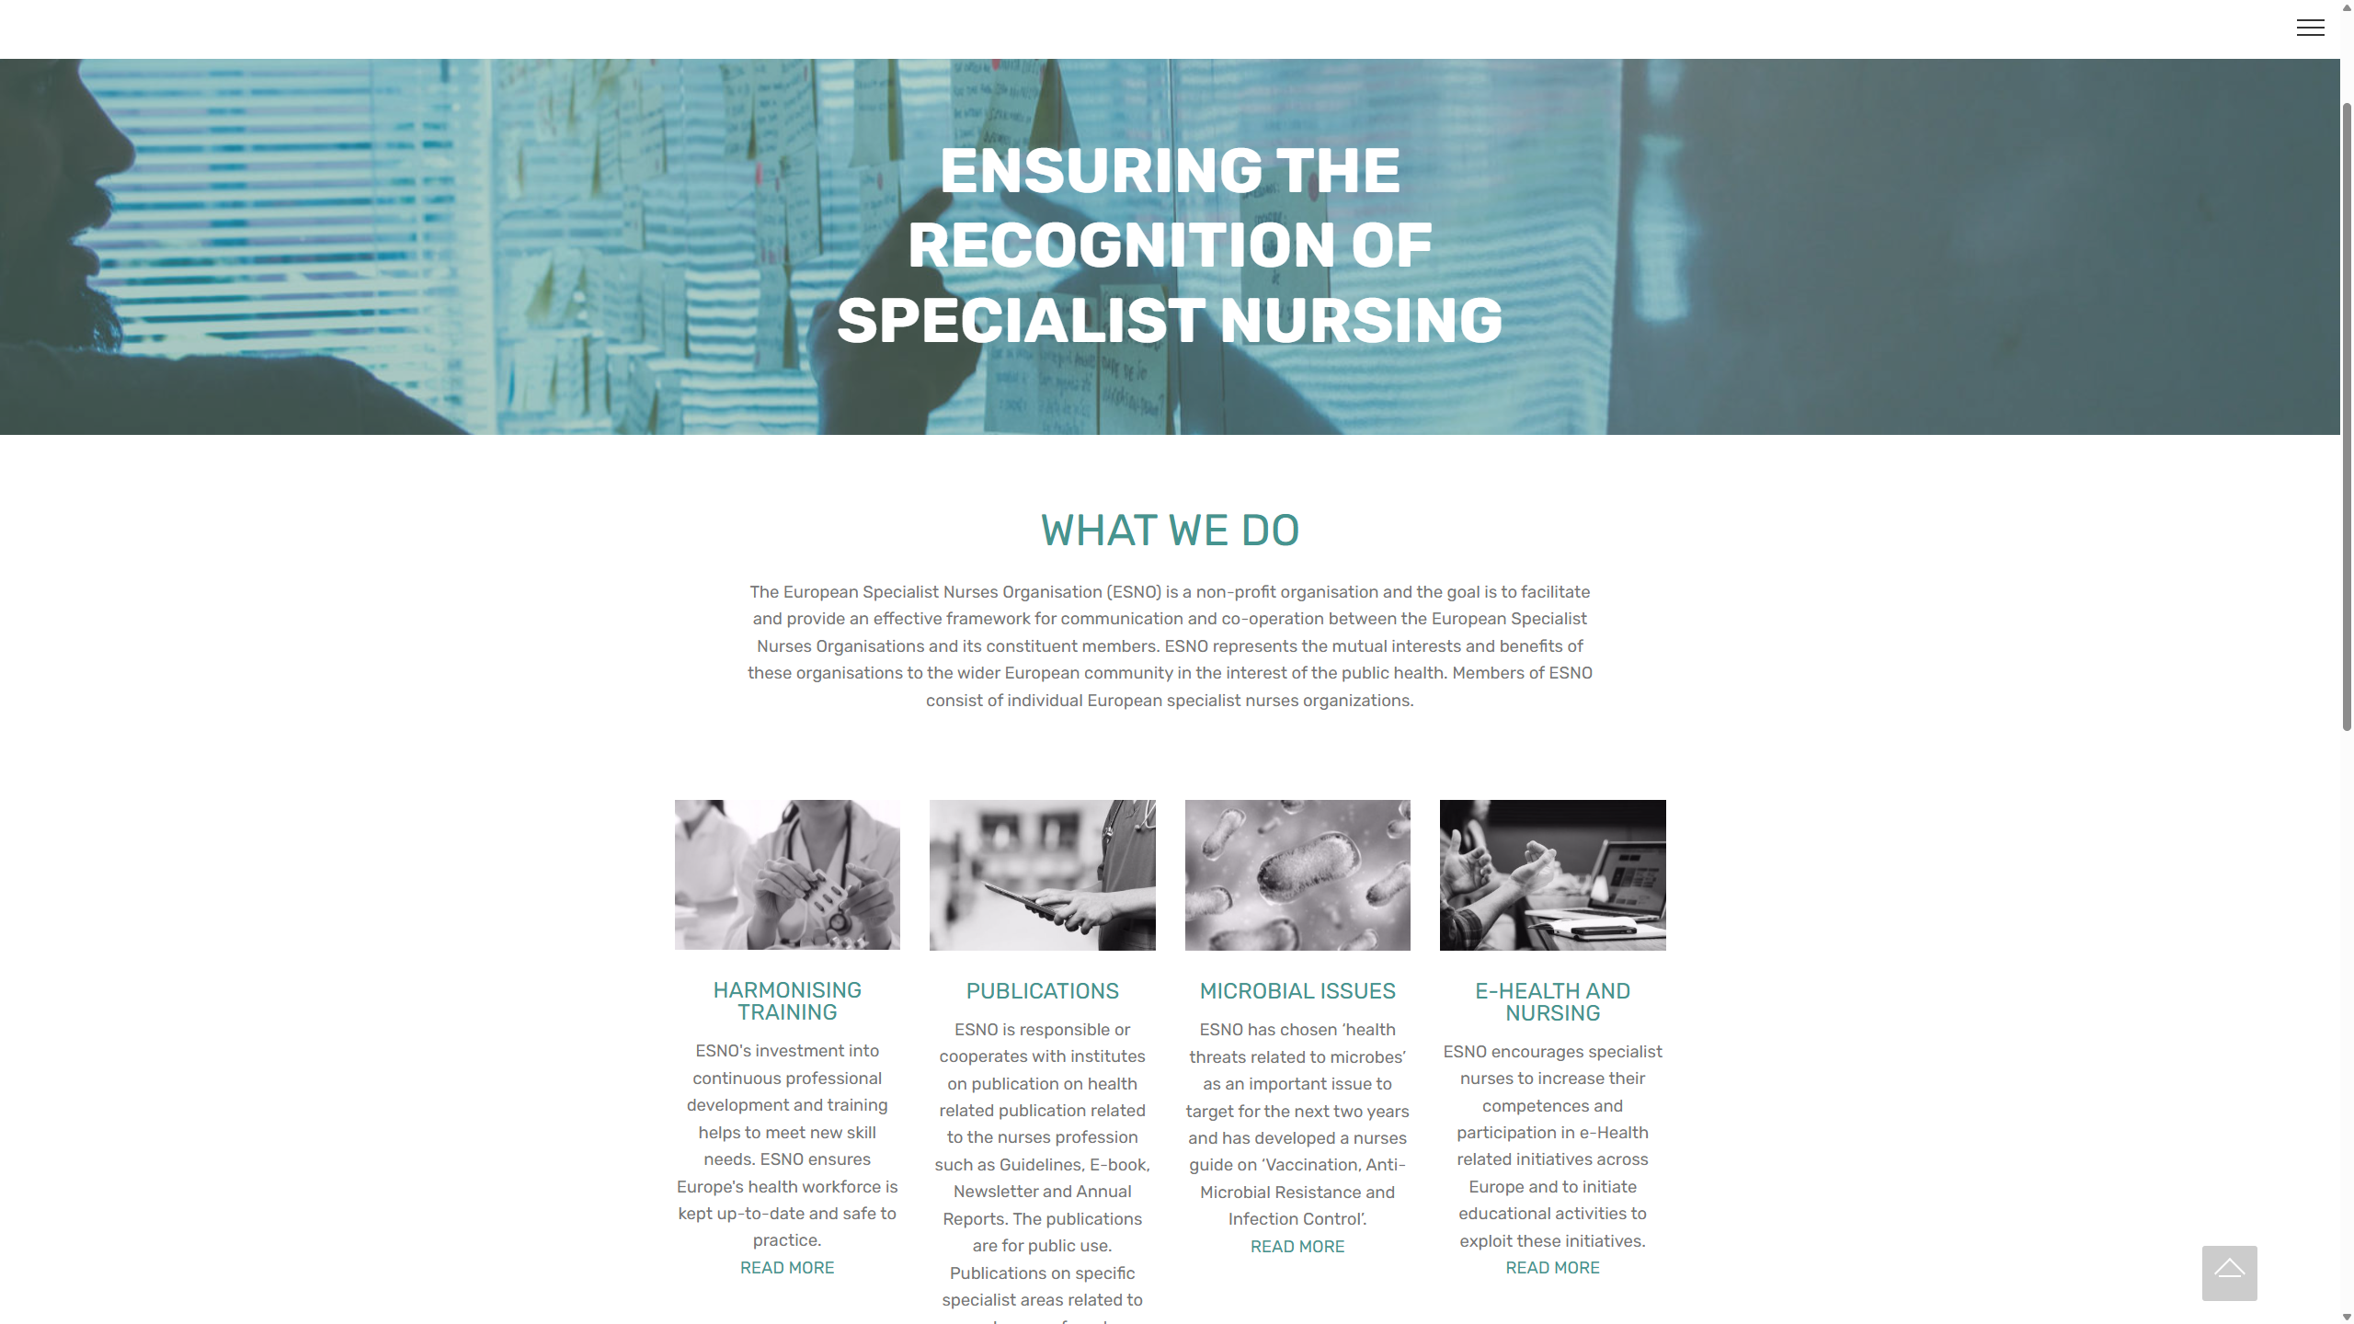

Slide 16


Slide 17


OUR ESNO MEMBERS AND ASSOCIATES
EDTNA/ERCA - European Dialysis and Transplant and Renal Care Association
EfCCNa - European federation of Critical Care Nursing associations
ENDA - European Nurse Directors Association
EORNA - European Operating Room Nurses Association
FEND - Foundation of European Nurses in Diabetes
IFNA - International Federation of Nurse Anesthetists
EAUN - European Association of Urology Nurses
ESGENA - Society of Gastroenterology and Endoscopy Nurses and Associate
EULAR - European League Against Rheumatism / Nurses section
EuSEN - European Society for Emergency Nursing
EANN - European Association Neuroscience Nurses
ACOVENE - Royal College of Veterinary Surgeons
EWMA - European Wound Management Association
ICRN - International Coalition Respiratory Nurses
FINE – European Federation of Nurse Educators in science
ENSA – European Nurses Student Association
ESCARDIO – European Society in Cardiology / Nurses
AIIAO - Italian Association Nurses in Oncology
GORNA - Greek Operating Room Nurses Association
AEEEMC - Specialist Nurses in Medical Surgical Nursing Portugal
ANIPIO - National Society Infection Control Nurses - Italy
PTPAIO - Polish Society of Anaesthesiology and Intensive Care
AEEEMC - Specialist Nurses in Medical Surgical Nursing Portugal
NVAM - Dutch association nurses in Anesthesia
AICO - Italian Association Operation Room Nurses
UISH - Albanian Order of Nurses
CNSARICT - Croatian Nursing Society of Anesthesia
CNNF - Croatian National Nursing Federation
BFHBOV - The Belgium Federation of Advance Nurses
V&VN - Dutch National Nursing Association
GPNNA - Greek Paediatric and Neonatology Nursing Association
Individual associates 473 nurses
Total about 3.850.000 nurses

Slide 18
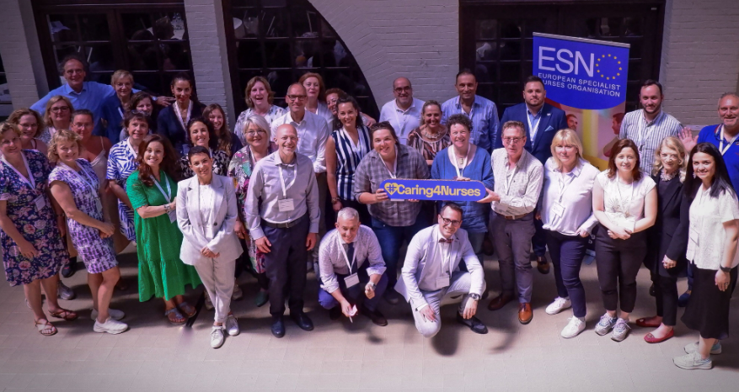
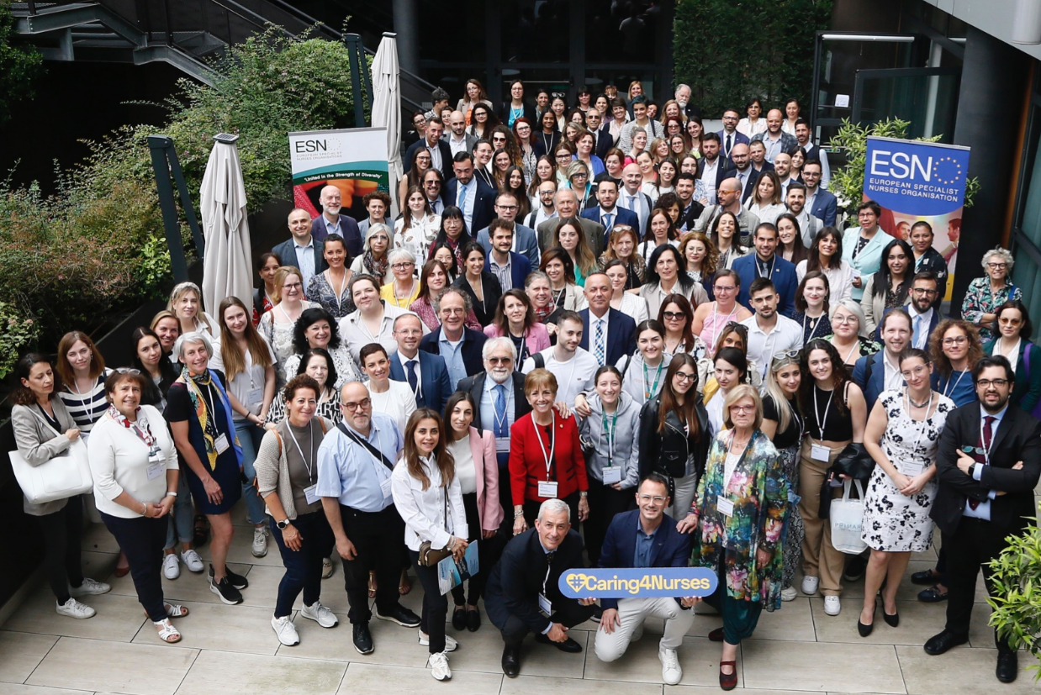
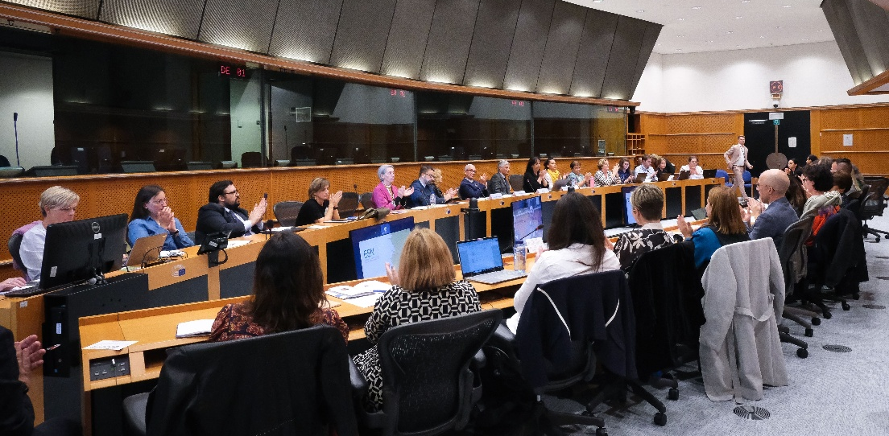

THE EUROPEAN SPECIALIST NURSE COMMUNITY

Slide 19
ESNO Program priorities 2024 - 2026
PILLAR - I
Influence in EU
Lobby for mission and vision
Participate in programs
Relation building MEP’s
PILLAR - II
Harmonization
Education
Certification
Recognition
PILLAR - III
EU Contribute to health issues
Vaccination, AMR
Preparedness
Science and research
PILLAR - IV
Nursing Wellbeing
Participation
Working condition
Mentor program
COMMITTEES

Slide 20


Programs on Nurse community in science
ESNO NURSES POOL
www.esnonursespool.eu
ESNO Nurses Survey Pool
Voicing the European Specialist Nursing expertise, science, education and experience.
This Nurse Pool program is an initiative of the ESNO Education and Scientific Committee, to create a portal for nurses in all specialities, motivated to engage in surveys, data collection and networking.

Slide 21

SECOND ESNO EVENT IN THE EUROPEAN PARLIAMENT
14-15 January 2025
In the context of the ‘Decade of the Specialist Nurses 2020 – 2030’
"EURO-NURSE 365”
Empowering Excellence in Nursing through Education, Certification, and European Recognition of a Framework on Specialist Nurses and Advance Nurse Practitioners.

Slide 22

The ESNO Response Toward Sustainability
Building a Relisient and Adaptable Nursing Workforce
Global Challenges Impacting Healthcare:
Economic slowdown, geopolotical tensions, climate crises, and workforce insyability threaten healthcare sustainability.
The Need for Workforce Resilience:
Addressing external pressures by ensuring a strong and well- supported nursing workforce.
ESNO’s Stretegic Vision:
Harmonizing education, certification, and professional recognition for specialisti nurses across Europe.

Slide 23
ESNO Declaration 2020-2030
1️⃣ Improve specialist nurse education & continuous professional development
2️⃣ Develop a harmonized framework for certification & qualifications across the EU
3️⃣ Establish automatic recognition of specialist nursing qualifications
4️⃣ Improve nurses’ economic conditions with fair salaries & benefits
5️⃣ Create positive work environments to reduce burnout & dissatisfaction
6️⃣ Provide clear career pathways to retain specialist nurses
7️⃣ Offer financial assistance & relocation support for professional mobility
8️⃣ Integrate digital, environmental & microbiology awareness in curricula
9️⃣ Harmonize prescribing practices & education standards for nurses in the EU
🔟 Foster interdisciplinary collaboration through shared decision-making & training
Key Actions for a Sustainable Nursing Workforce

Slide 24
ESNO Declaration 2020-2030
Key Actions for a Sustainable Nursing Workforce
Standarzide Education. Harmonized training programs acrossthe EU to ensure consistent expertise.
Recognition & Mobility Facilitating cross-border certification to support workforce flexibility.
Improved Working Conditions Offering fair salaries, reasonable workloads, and career development opportunities
Empowerment & Autonomy Granting nurses greater decision-making authority in clinical settings.

Slide 25
Si terrà a Roma, dal 4 al 6 giugno 2026, presso la Link Campus University di Roma, l’VIII Congresso internazionale ESNO (European Specialist Nurses Organisation)
"Obiettivi comuni, molteplici percorsi: unificare la formazione infermieristica specialistica in tutta Europa
Oggi, i sistemi sanitari europei sono sottoposti a un'enorme pressione, a causa del cambiamento demografico, delle malattie croniche e della crescente complessità assistenziale. A ciò si aggiungono le persistenti sfide della carenza di personale e dei vincoli economici. Eppure, in tutto questo, una verità rimane: il progresso e la specializzazione degli infermieri garantisce innovazione, conoscenza e leadership che rimodellano interi sistemi sanitari.
L’evento prevede sei cluster tematici: invecchiamento e vulnerabilità (dalle patologie croniche agli approcci palliativi); preparazione nei sistemi sanitari (inclusi prevenzione delle infezioni, vaccinazione, risposta alle epidemie e collaborazione sanitaria transfrontaliera, con gli infermieri come attori chiave nella costruzione di sistemi sanitari resilienti e orientati al valore); clima e sostenibilità; salute digitale e innovazione nella pratica infermieristica (AI, telemedicina, le tecnologie indossabili e le cartelle cliniche interoperabili); resistenza antimicrobica e farmacologia responsabile e salute mentale, resilienza e benessere della forza-lavoro (burnout, ambienti di lavoro sostenibili e sicurezza dei pazienti come base essenziale per l'erogazione di un'assistenza basata sul valore).

Slide 26

8th ESNO
4-6 JUNE 2026 ROME ITALY
EUROPEAN SPECIALIST NURSES ORGANISATION

Slide 27
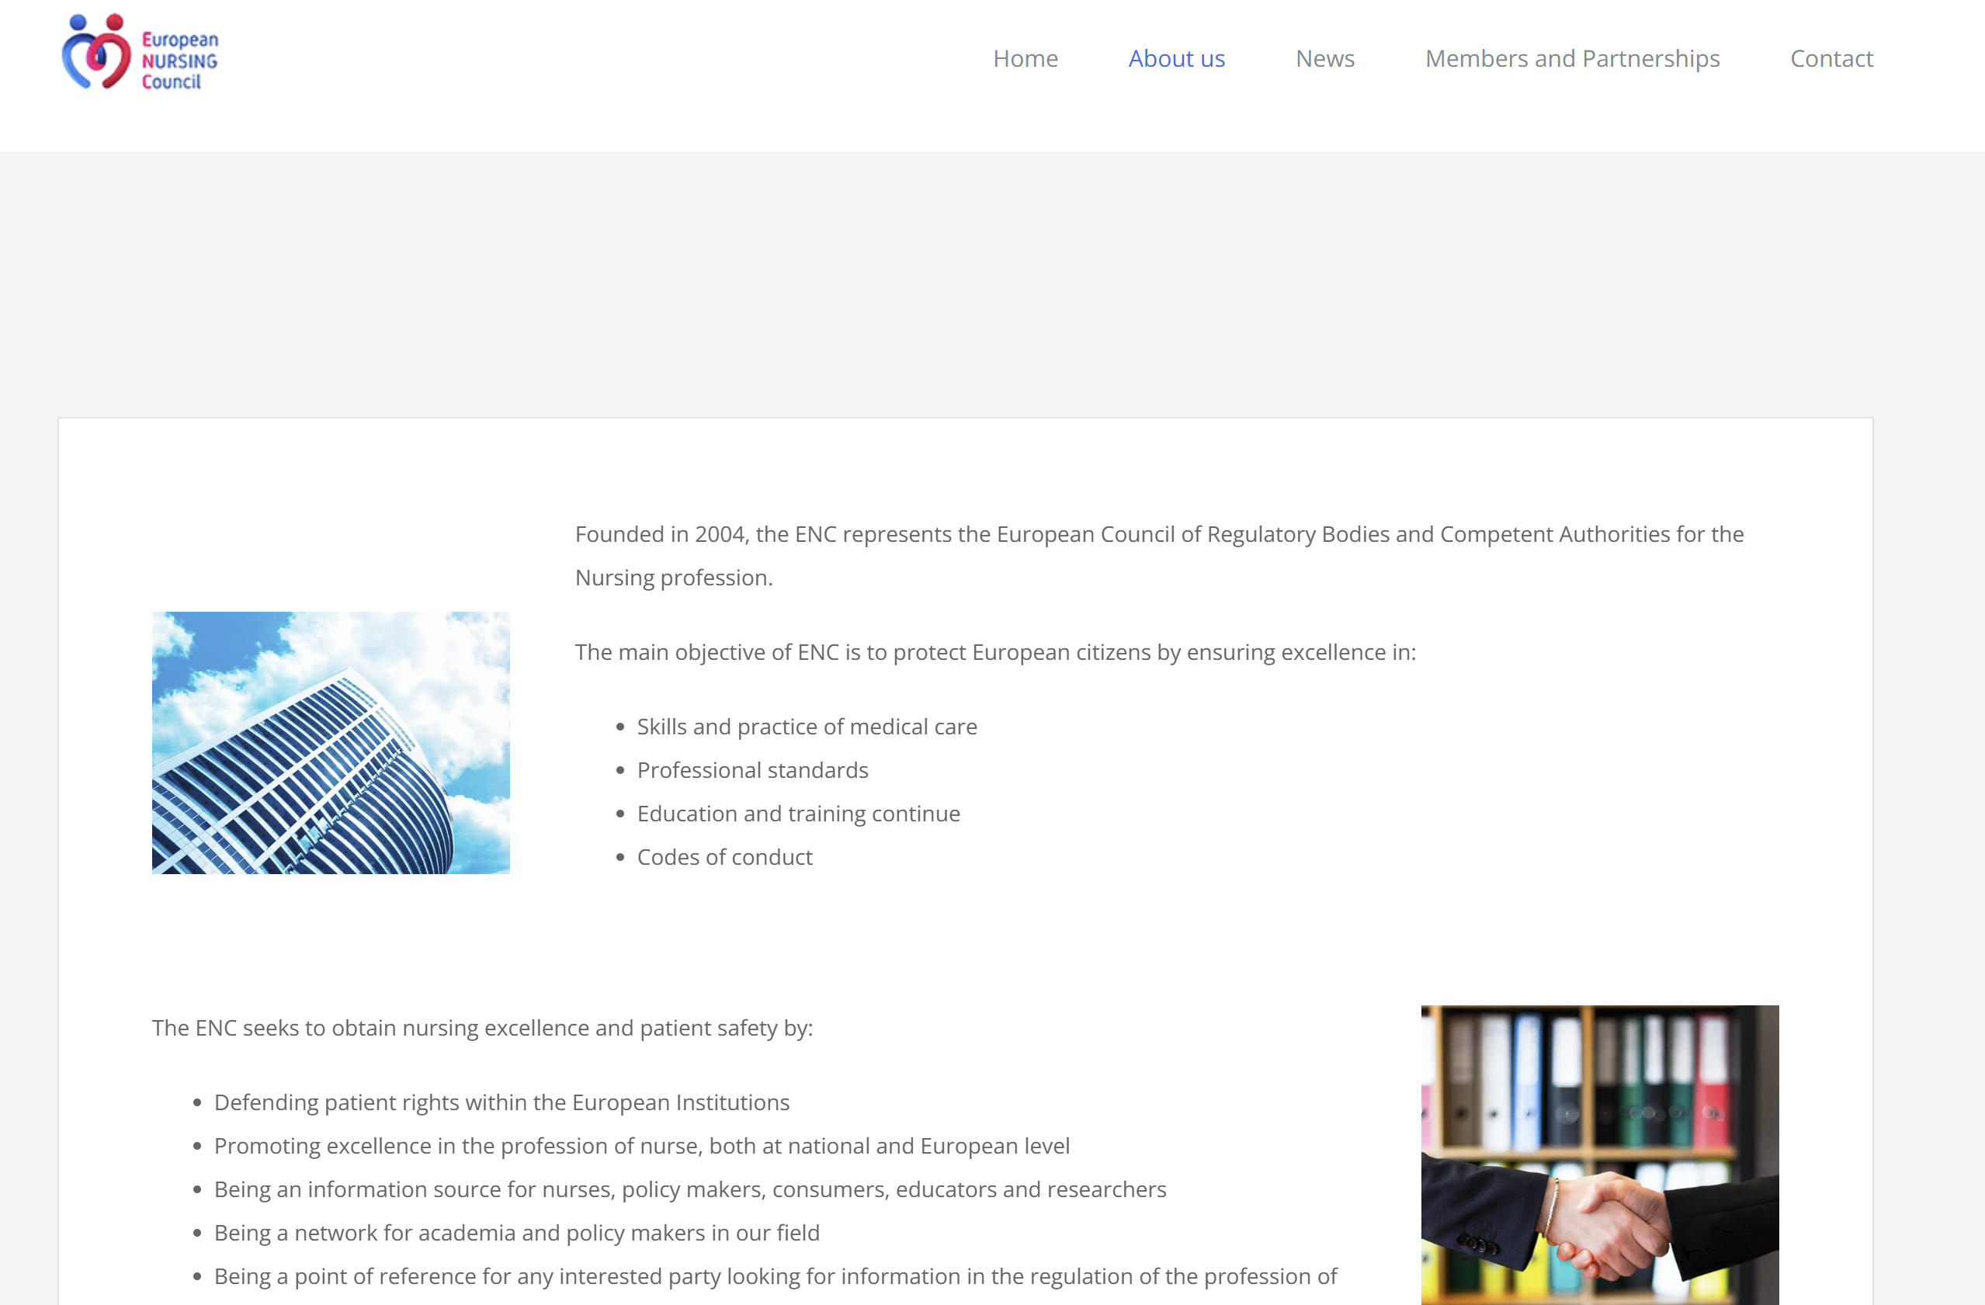

Slide 28
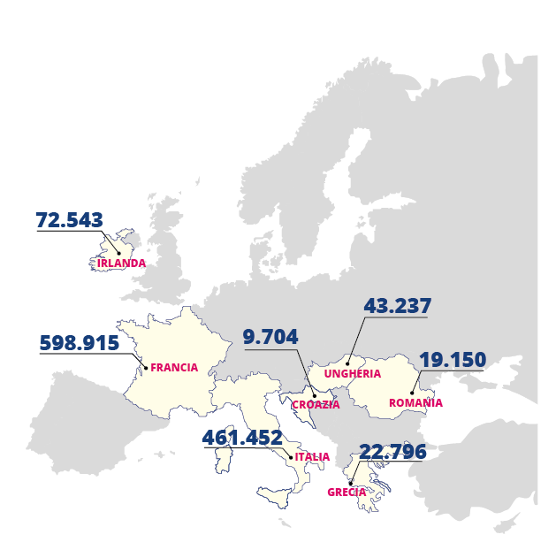

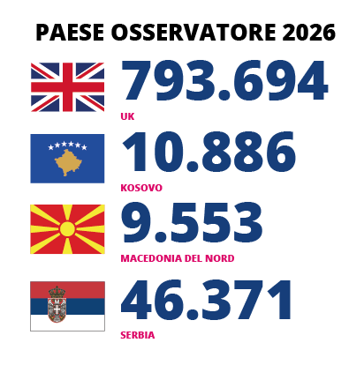
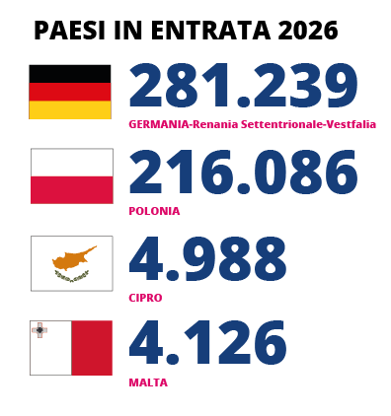
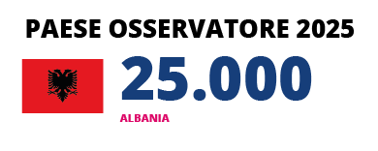
Il "peso" di ENC - European Nursing Council
La rete conta attualmente oltre 1,2 milioni di infermieri
OBIETTIVO 2026/27 passare a 2,6 milioni di professionisti rappresentati con i nuovi Paesi in entrata
TOT. 2.619.740
FONTE - https://ec.europa.eu/eurostat/statistics-explained/index.php?title=Healthcare_personnel_statistics_-_nursing_and_caring_professionals
FONTE - https://infermierepershqiperine.al/
FONTE - https://oik-ks.org/
FONTE - https://www.nmc.org.uk/
FONTE - https://www.dbfk.de/de/index.php
FONTE - https://statistik.nrw/gesellschaft-und-staat/gesundheit/pflege

Slide 29
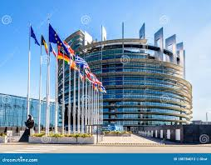
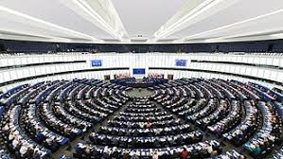
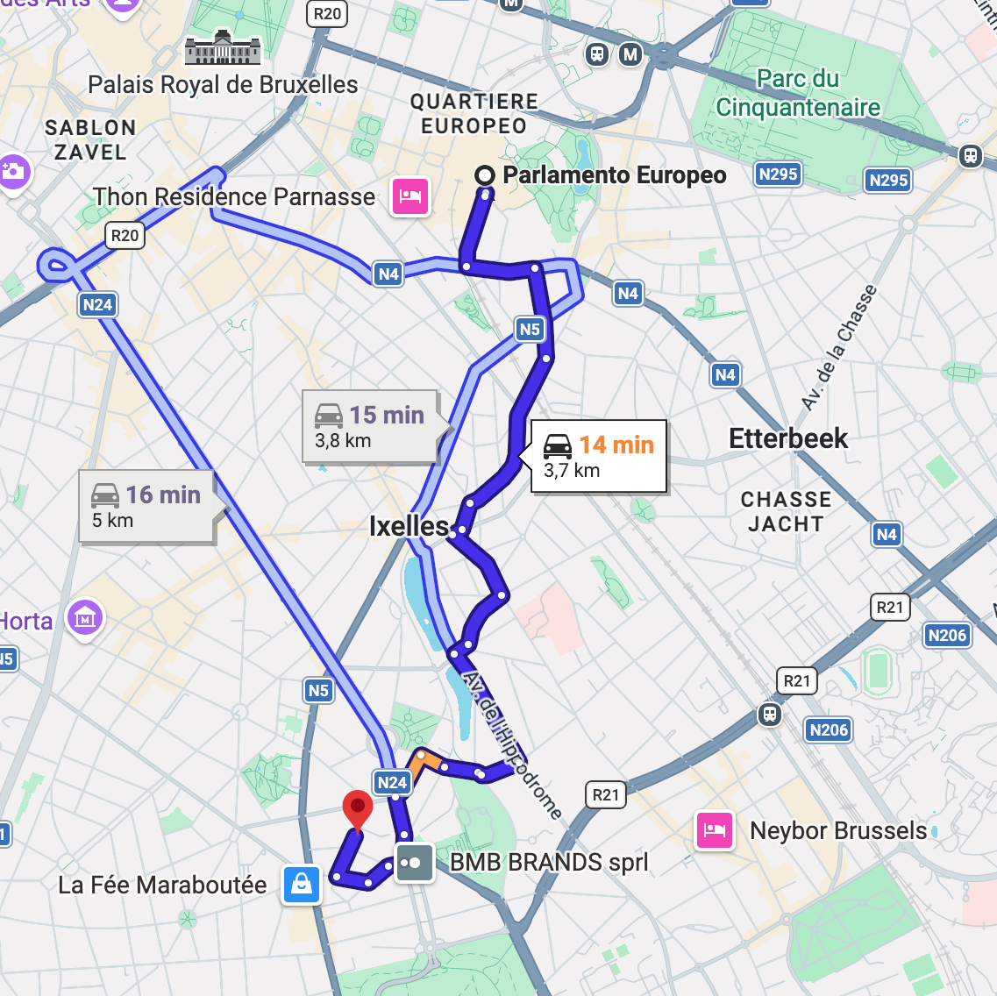

Rue Saint-Georges, 32, B-1050 Bruxelles.

Slide 30
Thank You

